Slide 1

ABP Studio
The Missing Tool for .NET Developers

Slide 2

Agenda
What is ABP Studio? Why We’ve Built it?
Demo
Installation & Overview
Basics: Creating solutions / Using ABP & .NET CLI commands
Building modular & complex applications
Developing, running and monitoring distributed dystems
Working with Kubernetes
Working with ABP Suite
.NET Aspire?
Road Map
Licensing
Next ABP Studio Events

Slide 3
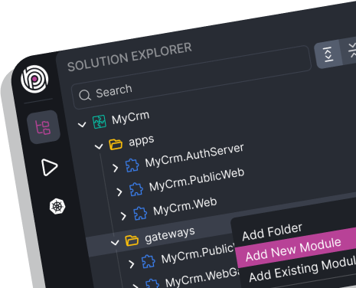
ABP Studio: What it is?
A cross-platform desktop application for ABP developers!
A tool you use daily to simplify or automate your non-coding activities
It is not a coding IDE (e.g. Visual Studio)

Slide 4
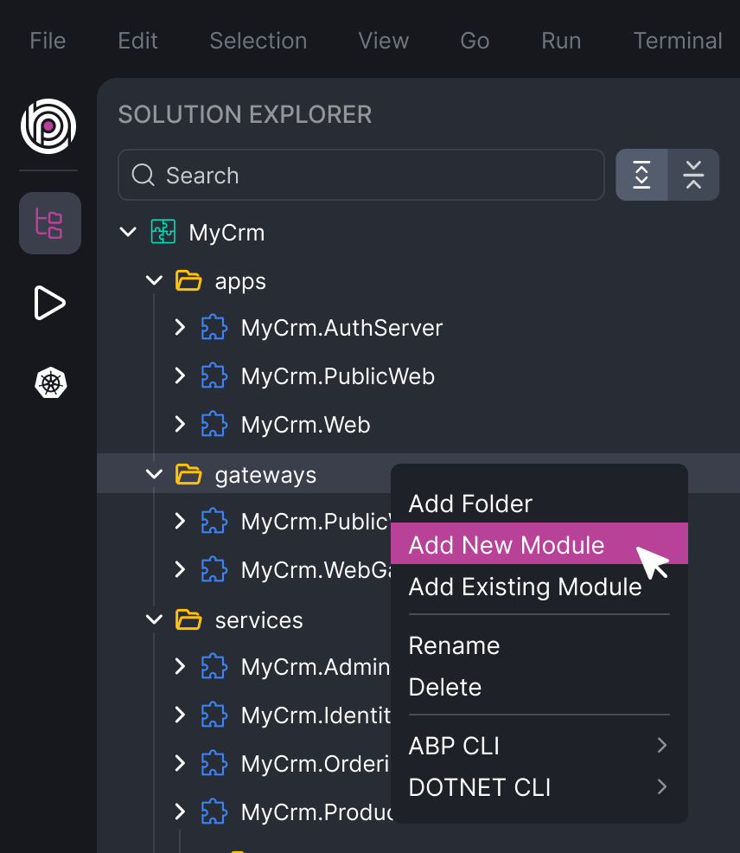
ABP Studio: Why?
A single wiew of a system consists of multiple .NET solutions
Architecting complex software solutions
Modular monoliths
Microservice / distributed systems
Building & managing multi-package or layered modules
Install, uninstall and explore external modules

Slide 5
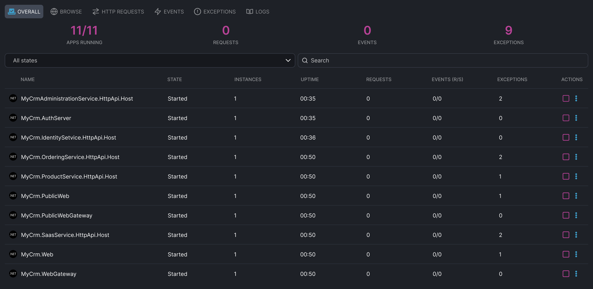
ABP Studio: Why?
A single UI to control multi-application solutions
Running multiple applications/services with a single click
Browse, monitor, trace and debug problems across applications/services

Slide 6
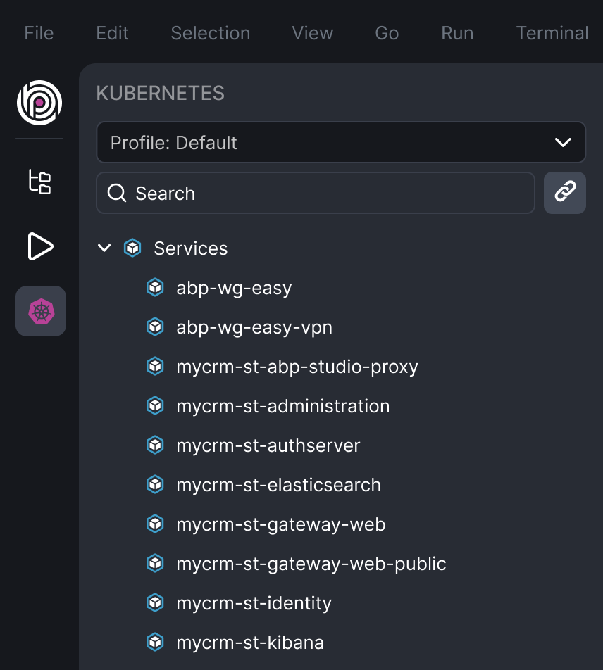
ABP Studio: Why?
A comfortable development environment for Kubernetes
Seemlessly integrate your local environment to a Kubernetes cluster
Access internal services
Intercept traffic to run, debug and develop a service in your local environment

Slide 7
Topic title
Content

Slide 8
Topic title
Content

Slide 9
Topic title
Content

Slide 10
Topic title
Content

Slide 11
Topic title
Content

Slide 12
Topic title
Content

Slide 13
Topic title
Content

Slide 14
Topic title
Content

Slide 15
Topic title
Content

Slide 16
Topic title
Content

Slide 17
Topic title
Content

Slide 18
Topic title
Content

Slide 19
Topic title
Content

